Slide 1
What Have We Missed?
Our forecasts have been…
based more heavily on recent data
good at filtering out some of the random noise
But there are factors we haven’t captured
Trends
Seasonality
Other variables

Slide 2
Trend

Slide 3
Trend
Average forecast: 20.1 Average actual value (excluding t = 1): 18.7

Slide 4
Nonconstant Trend

Slide 5
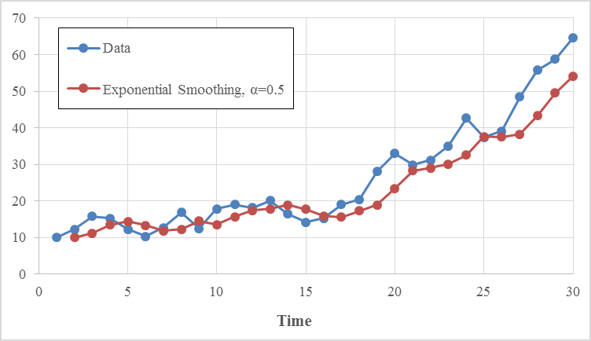
Nonconstant Trend

Slide 6
Double Exponential Smoothing
Trend is captured by double exponential smoothing
Includes a second parameter (β) and an extra equation to keep track of trend
Still possible to make forecasts manually, but requires more calculation
Harder to choose α and β than α only
R can optimize both α and β

Slide 7
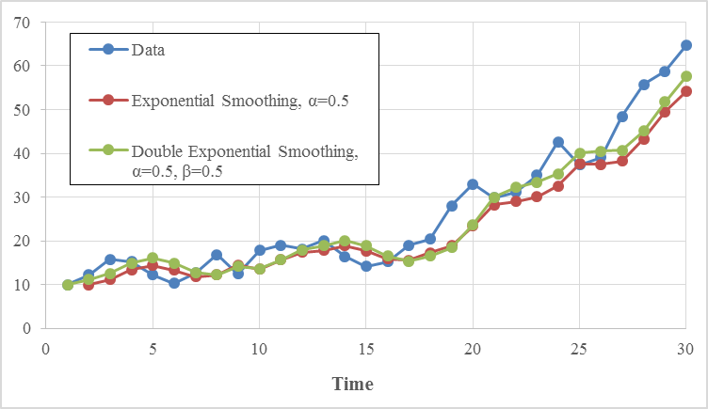
Double Exponential Smoothing
MSE of 23.5 vs. 31.3

Slide 8
Seasonality
Another common property of time series is seasonality
Regular predictable cycles in the data
By hour, day, month, quarter

Slide 9
Seasonality Examples
Retail sales are typically higher in December
Restaurants are busier at mealtimes
Amount of rainfall differs by month
Household energy usage differs by month

Slide 10
Seasonality (and Trend)
In this time series, the seasonal factor for December will be very high (November and January also slightly high).

Slide 11
Holt-Winters Model
An exponential smoothing method that captures both trend and seasonality
In addition to keeping track of forecasts and current trend, also includes seasonal factors
Again, R can optimize all parameter values
“Deseasonalizes” data, then does double exponential smoothing (and puts seasonal effects back in)
Two types: multiplicative and additive

Slide 12
How do we know which forecasting model to use?

Slide 13
By Inspection?
Sometimes it’s obvious just from looking at a line chart
To identify trend: look for clear obvious long-term growth and/or decline
To identify seasonality: look for fixed-length cycles
Note unit of time used in the data

Slide 14
Challenge
But it’s not always obvious!
How much trend/seasonality do we need to see to justify a more complex model?
We want to capture real effects, but don’t want an unnecessarily complicated forecasting model
No perfect way to judge visually

Slide 15
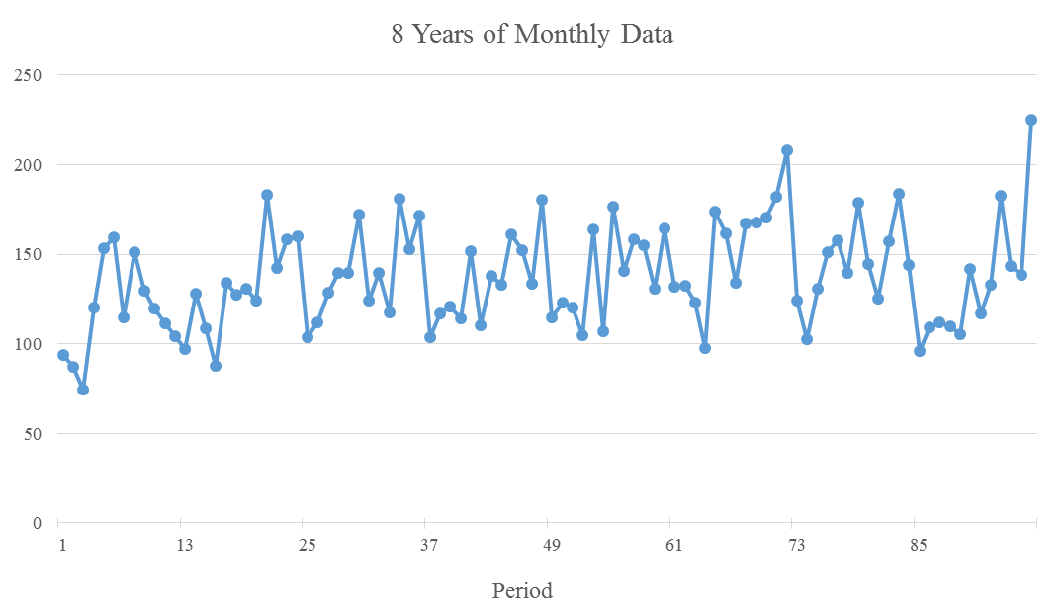
Which Model to Use?

Slide 16
Overfitting
What’s wrong with using an extremely complex forecasting model?
Why not always use the fanciest & most flexible method? (in this case, Holt-Winters?)
It can interpret random noise from a small number of data points as having predictive value.
More complex methods tend to work better with larger data sets.

Slide 17
Bonus Material

Slide 18
Partitioning
Build the models using this portion of the data.
Then use them to predict this portion of the data.

Slide 19
Partitioning
Ignore the most recent data when fitting the models
Typically the most recent 20–40% of points
Then use each model to “predict” the recent data points as if they were new
Each prediction has an error associated with it
Compute MSE for each model

